Slide 1
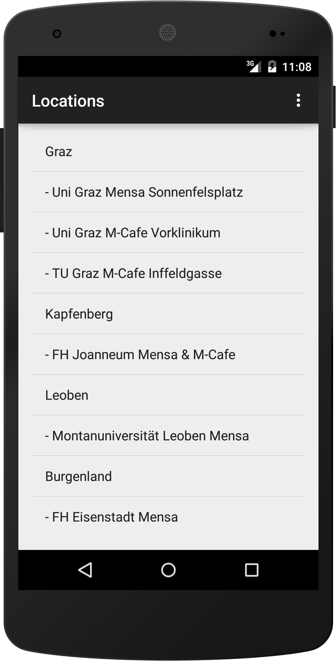
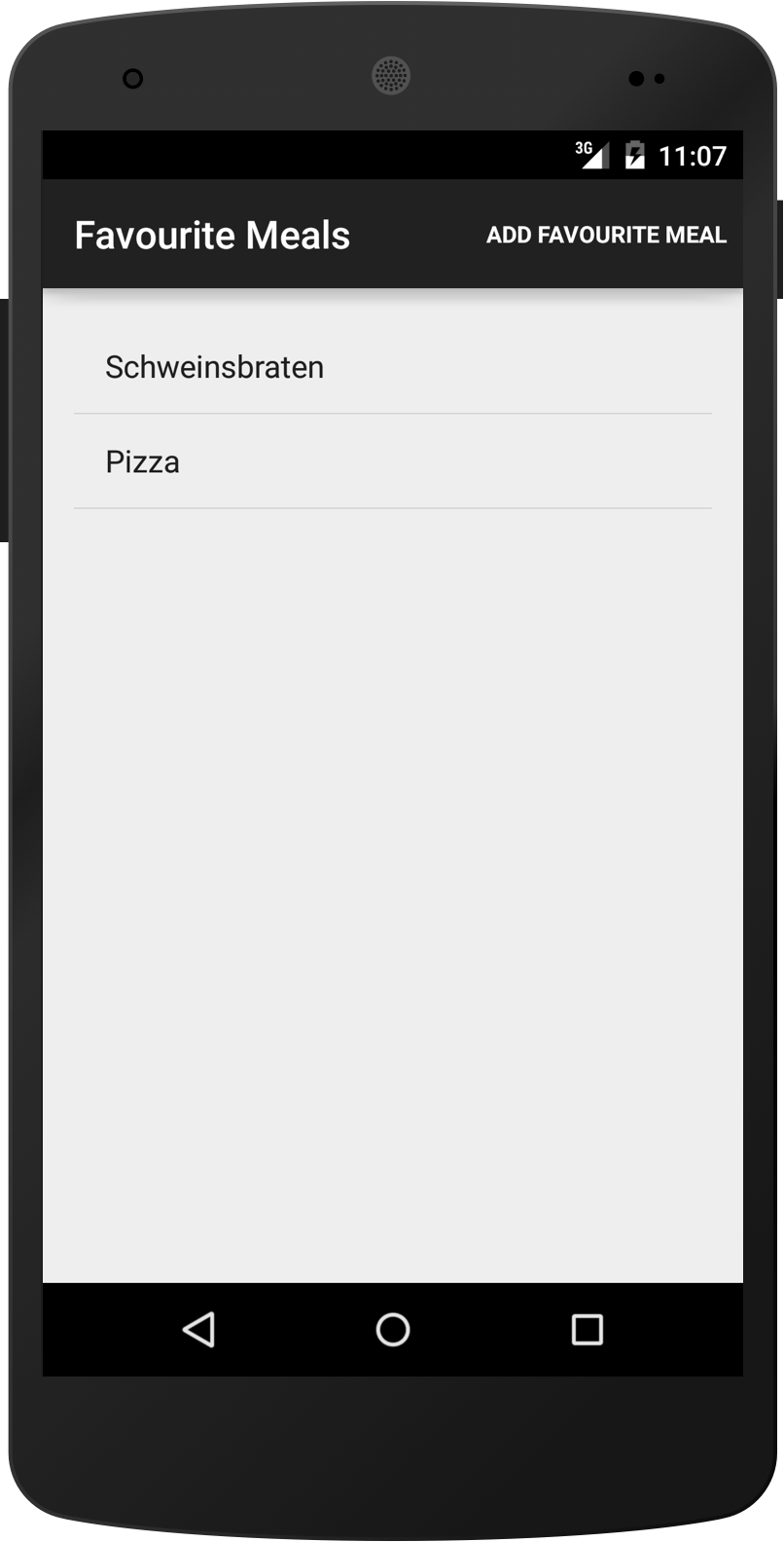
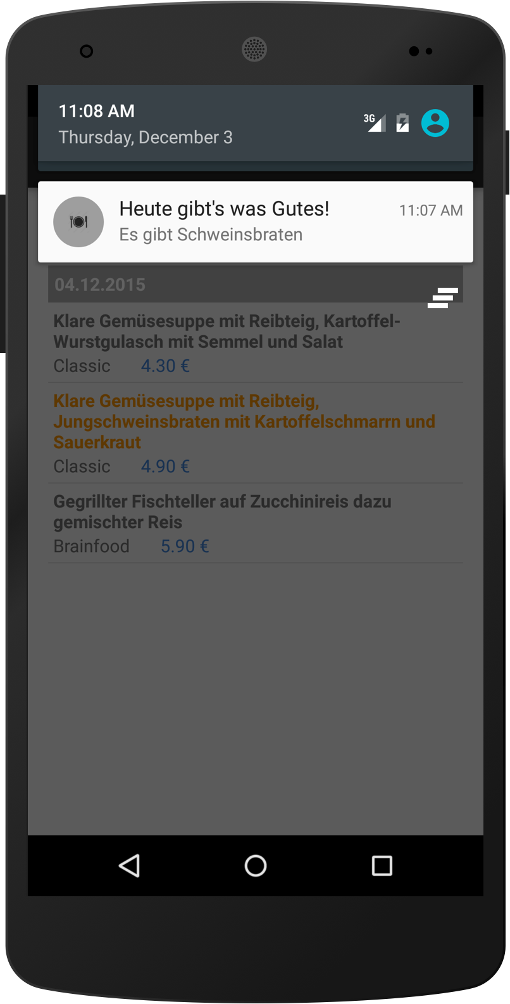
Mensa App
ITM13
Stifter, Wachtler
An Android application which provides an easy way to look up your Mensa menu
Features
Check out weekly Mensa meal plan
Save your favorite dishes within the app
Isn't it great to know when it's time for your favorite dish? The built-in notifications will never let you miss it!

